Slide 1
ALGEBRA 4
Day 45

Slide 2
Bell Work: f(x) = 2x² + 12x - 31x² – 8 - 3x⁴
Standard Form:
Lead Coefficient:
Constant:
Degree:
End Behavior:

Slide 3
From Last Time
page 285 #3-5, 9-27 (odd), 39, 43, 48
***For 9–27 and 43 change directions to:
Write in Standard Form, Identify the Degree, Lead Coefficient, Constant, and End Behavior

Slide 4
5.2 Polynomials, Linear Factors, and Zeros
Objective:
To Analyze the Factored form of a Polynomial.
To write a Polynomial function from its Zeros.

Slide 5
Given a polynomial P(x)…
If we are told that (x-b) is a linear factor of P(x), we know:
b is a zero of the polynomial function P(x)
b is a root (solution, zero) of the polynomial equation P(x)=0
b is an x-intercept of the graph of P(x)

Slide 6
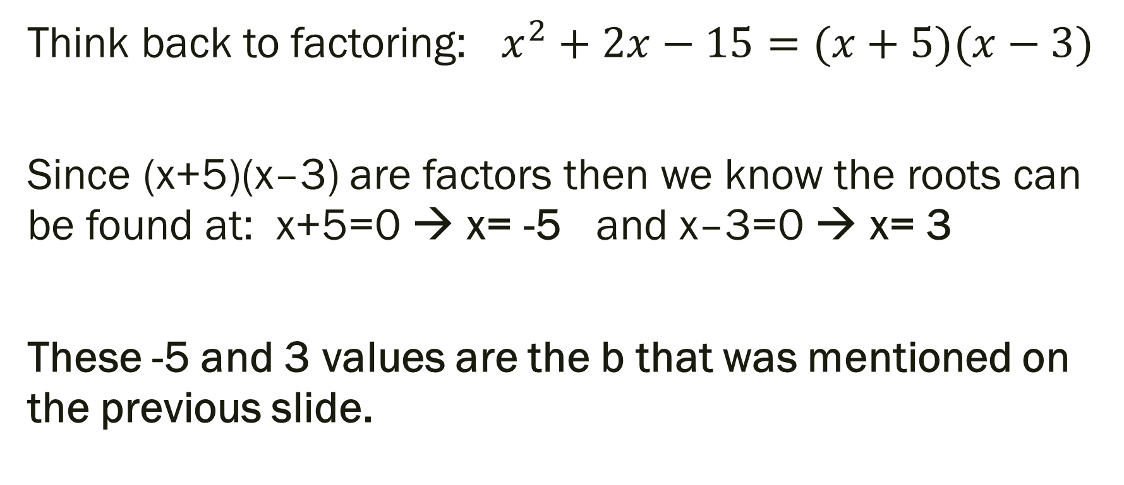
What the heck did that mean?!
Think back to factoring: $x^{2}+2x−15=(x+5)(x−3)$
Since (x+5)(x–3) are factors then we know the roots can be found at: x+5=0 → x= -5 and x–3=0 → x= 3
These -5 and 3 values are the b that was mentioned on the previous slide.

Slide 7
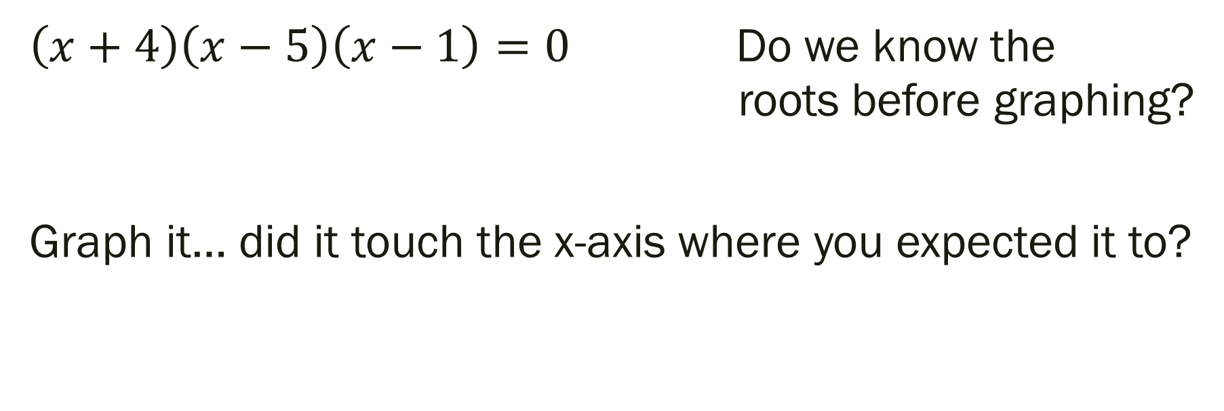
Expand this concept…
$\left(x+4\right)\left(x−5\right)\left(x−1\right)=0$ Do we know the roots before graphing?
Graph it… did it touch the x-axis where you expected it to?

Slide 8
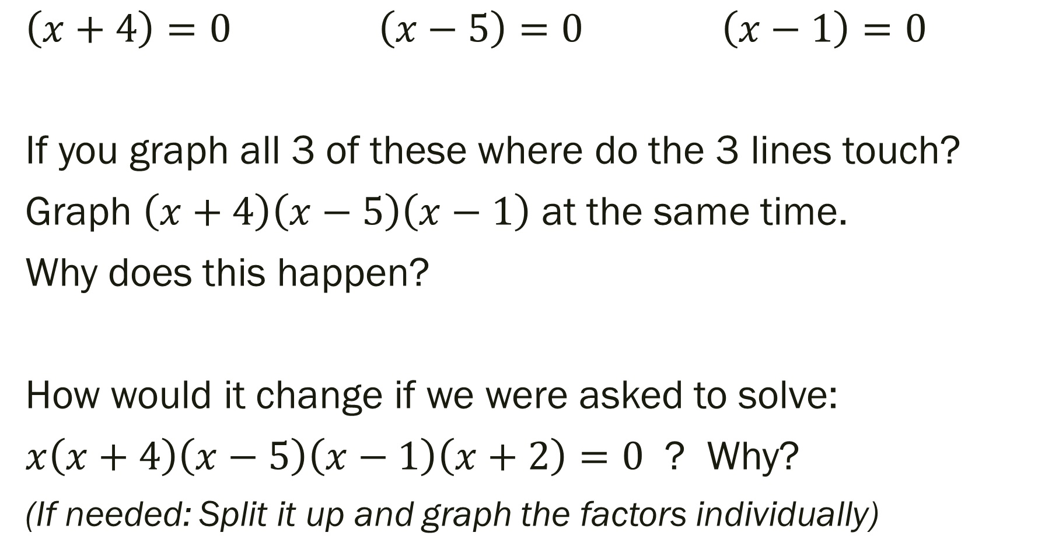
Go Deeper… Split it up!
$$\left(x+4\right)=0 \left(x−5\right)=0 \left(x−1\right)=0$$
If you graph all 3 of these where do the 3 lines touch?
Graph $\left(x+4\right)\left(x−5\right)\left(x−1\right)$ at the same time.
Why does this happen?
How would it change if we were asked to solve:
$x\left(x+4\right)\left(x−5\right)\left(x−1\right)\left(x+2\right)=0$ ? Why?
(If needed: Split it up and graph the factors individually)

Slide 9

Writing a Polynomial in Factored Form: $$x^{3}+5x^{2}+6x$$
Hint: Find the GCF

Slide 10
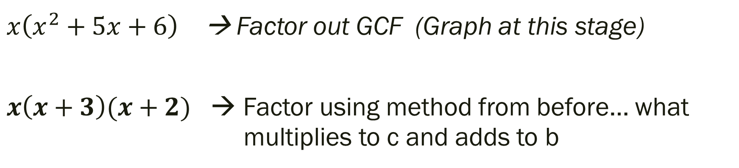
Writing a Polynomial in Factored Form: $$x^{3}+5x^{2}+6x$$
$x\left(x^{2}+5x+6\right)$ → Factor out GCF (Graph at this stage)
$x\left(x+3\right)(x+2)$ → Factor using method from before… what multiplies to c and adds to b
How could we have used the roots of the original graph to help us factor?

Slide 11
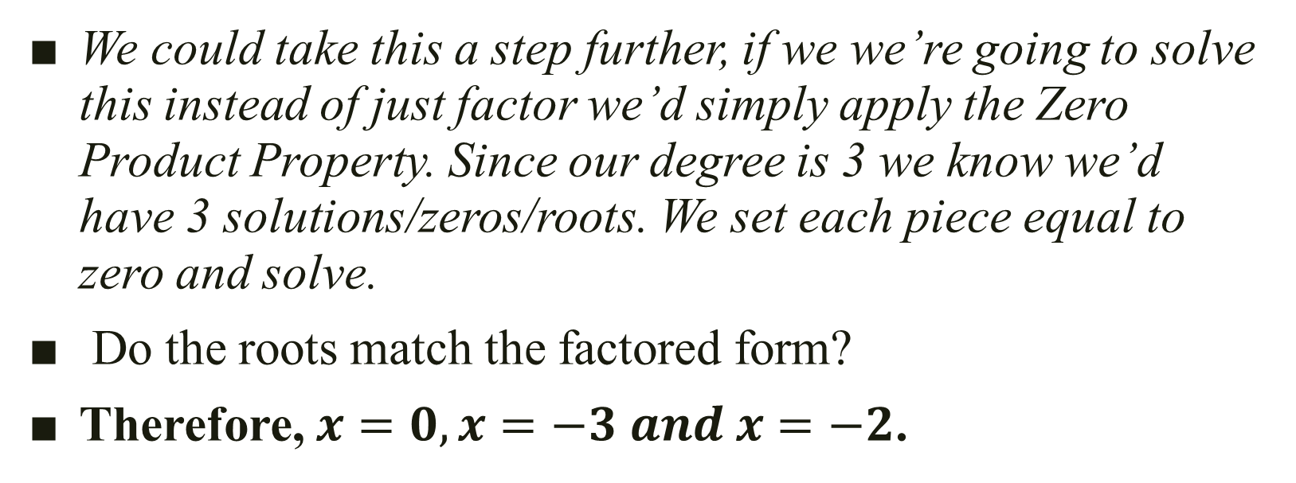
Thinking ahead… (more for next time than this time)
We could take this a step further, if we we’re going to solve this instead of just factor we’d simply apply the Zero Product Property. Since our degree is 3 we know we’d have 3 solutions/zeros/roots. We set each piece equal to zero and solve.
Do the roots match the factored form?
Therefore, $x=0, x=−3 and x=−2$.

Slide 12
Using Zeros to Write Polynomial Functions If k is a zero, then we know x – k is a factor.
For Example…
If we know a, b, and –c are the zeros, then:
f(x) = (x – a)(x – b)(x + c)

Slide 13
Write a polynomial function of least degree that has real coefficients, the given zeros, and a leading coefficient of 1
Zeros at: 2, -1, 4

Slide 14
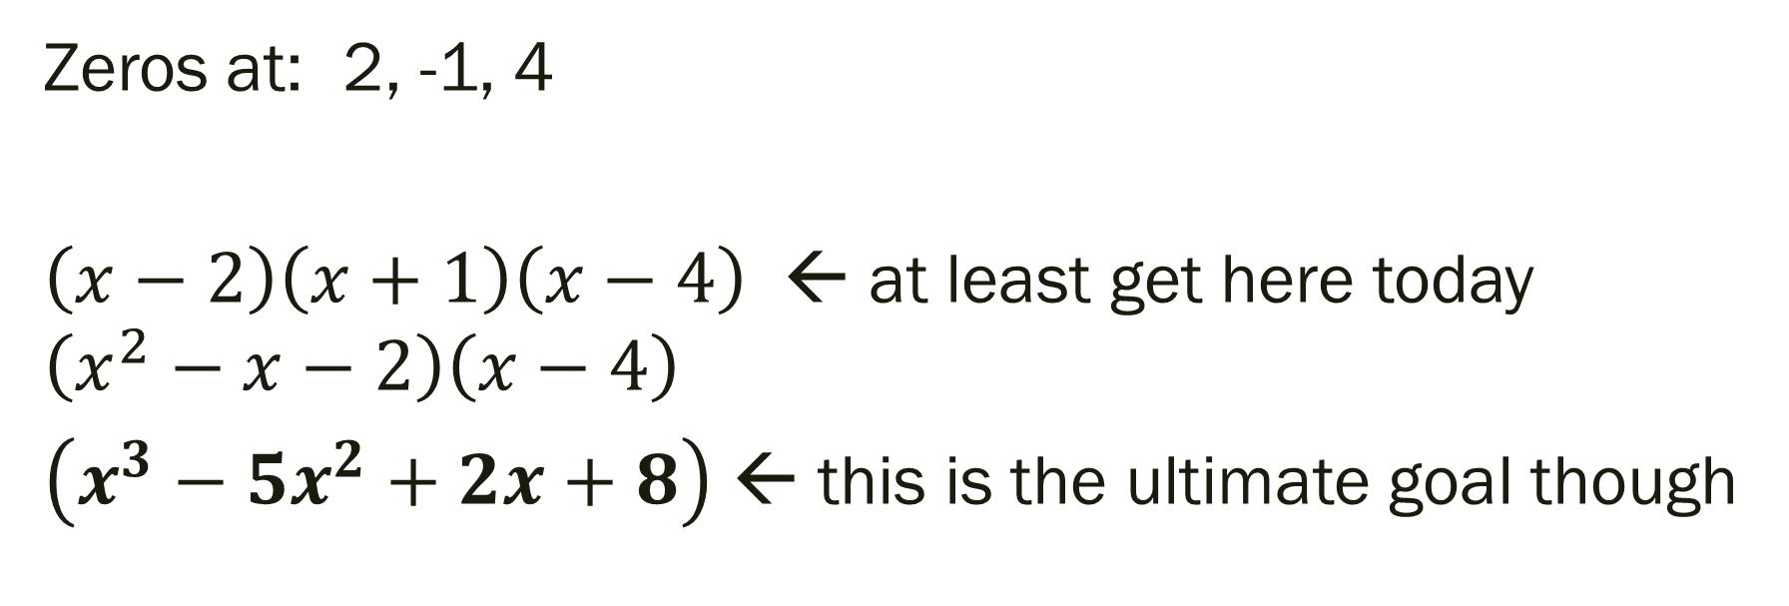
Write a polynomial function of least degree that has real coefficients, the given zeros, and a leading coefficient of 1
Zeros at: 2, -1, 4
$\left(x−2\right)\left(x+1\right)\left(x−4\right)$ ← at least get here today
$$\left(x^{2}−x−2\right)\left(x−4\right)$$
$\left(x^{3}−5x^{2}+2x+8\right)$ ← this is the ultimate goal though

Slide 15
Note: The complex zeros of a polynomial function with real coefficients always occur in complex conjugate pairs
If a + bi is a zero, then a – bi must also be a zero.
Example: Identify all roots:
1.) If 4, -3, and -5i are roots?
2.) If 6, 4 + 3i are roots?

Slide 16
Note: The complex zeros of a polynomial function with real coefficients always occur in complex conjugate pairs
If a + bi is a zero, then a – bi must also be a zero.
Example: Identify all roots:
1.) If 4, -3, and -5i are roots? 5i is also a root
2.) If 6, 4 + 3i are roots? 4 – 3i is also a root

Slide 17
For Next Time
Page 293 #1-6, 7-23 (odd), 27-31 (odd)

